Slide 1

County Franchise Expansion 2021
Oakland County, MI
Bergen County, NJ
Prepared by Andre Buser
August 23rd, 2021
Notes:
DARKER PINK OF LOGO:
hexcode #AA3660
RGB (170, 54, 96)
CMYK (14, 27, 14, 89)
LIGHTER PINK OF LOGO:
hexcode #DE5498
RGB (222, 84, 152)
CMYK (8, 75, 4, 0)
GREEN (not required to use because it's not part of their logo):
hexcode #C1C139
RGB (193-193-57)
CMYK (196, 6, 93, 8)

Slide 2

Today we will discuss…
Methodology
Data Sources
Key Success Criteria
The Geographical Locations
Our Recommendation
Insights
Total Population
Young Population
Income Growth (100k+)
Infrastructure
Peer Competitors
Why not Bergen County, NJ
Recommended Next Steps
Notes:
DARKER PINK OF LOGO:
hexcode #AA3660
RGB (170, 54, 96)
CMYK (14, 27, 14, 89)
LIGHTER PINK OF LOGO:
hexcode #DE5498
RGB (222, 84, 152)
CMYK (8, 75, 4, 0)
GREEN (not required to use because it's not part of their logo):
hexcode #C1C139
RGB (193-193-57)
CMYK (196, 6, 93, 8)

Slide 3
Methodology: Data Sources
Demographic Data
American Community Survey (ACS) via CensusReporter.org
United States Census data via Gale Business DemographicsNow
Consumer Data
Consumer behavior and profile data were gleaned from the Gale Business DemographicsNow
World Wide Web Data
Google Maps
Wikipedia
Yelp
Notes:
For the data-driven and objective evaluation process the following data sources were considered:
- Demographic Data: For the comparison of the two counties data from the following demographic sources was gathered:
American Community Survey (ACS) from 2019 via CensusReporter.org
United States Census data via Gale Business DemographicsNow, from 2000 to 2010, plus estimated and projected data from 2020 and 2025

Slide 4
Methodology: Key Success Criteria
Total Population
Stable or increasing population of young people
Income Growth
Infrastructure
Peer Competitors
Notes:
DARKER PINK OF LOGO:
hexcode #AA3660
RGB (170, 54, 96)
CMYK (14, 27, 14, 89)
LIGHTER PINK OF LOGO:
hexcode #DE5498
RGB (222, 84, 152)
CMYK (8, 75, 4, 0)
GREEN (not required to use because it's not part of their logo):
hexcode #C1C139
RGB (193-193-57)
CMYK (196, 6, 93, 8)

Slide 5
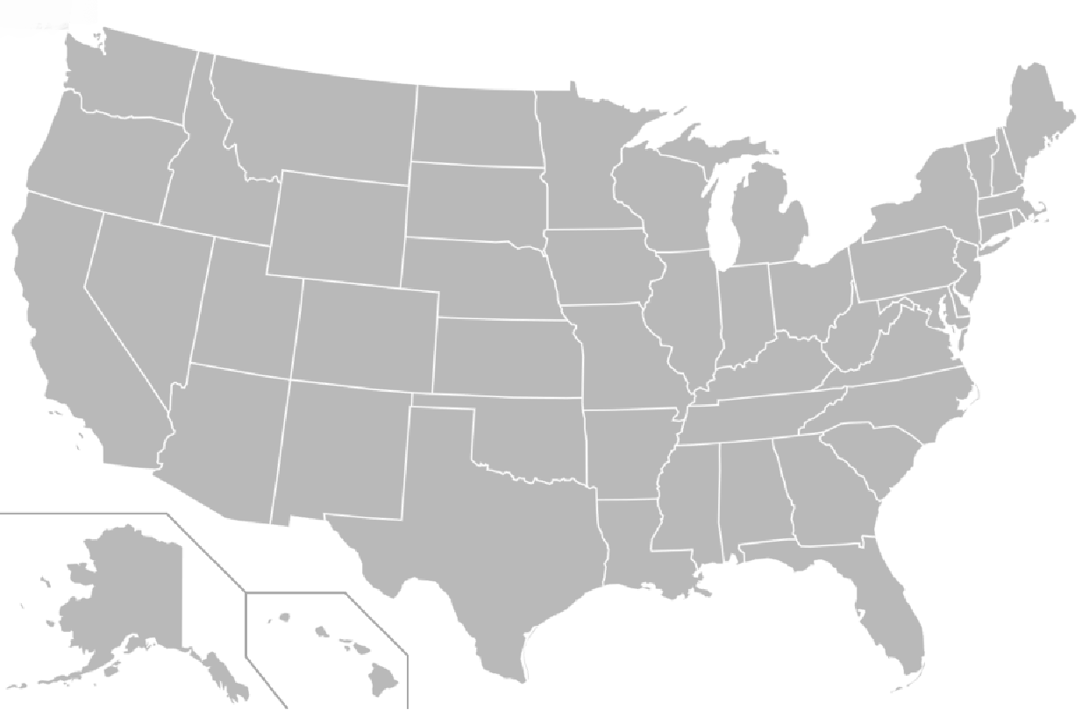
Oakland County, MI
Bergen County, NJ
Source: Map – Wikipedia, August 22nd, 2021.

Slide 6

Our Recommendation: Oakland County, MI
Source: Logo – Wikimedia.org, August 22nd, 2021.
Notes:
DARKER PINK OF LOGO:
hexcode #AA3660
RGB (170, 54, 96)
CMYK (14, 27, 14, 89)
LIGHTER PINK OF LOGO:
hexcode #DE5498
RGB (222, 84, 152)
CMYK (8, 75, 4, 0)
GREEN (not required to use because it's not part of their logo):
hexcode #C1C139
RGB (193-193-57)
CMYK (196, 6, 93, 8)

Slide 7
Insights: Oakland has the BIGGER Total Population 2020¹
1,257,982
941,439
Oakland County, MI
Bergen County, NJ
Source: Complete Demographic Comparison Report by Gale Business DemographicsNow, Aug. 16th, 2021 | ¹ Estimated for 2020
Notes:
DARKER PINK OF LOGO:
hexcode #AA3660
RGB (170, 54, 96)
CMYK (14, 27, 14, 89)
LIGHTER PINK OF LOGO:
hexcode #DE5498
RGB (222, 84, 152)
CMYK (8, 75, 4, 0)
GREEN (not required to use because it's not part of their logo):
hexcode #C1C139
RGB (193-193-57)
CMYK (196, 6, 93, 8)

Slide 8
Insights: Young Population (age 20 to 44)
Stable at
~31,5%
1
2
Chart: Andre Buser | Source: Complete Demographic Comparison Report by Gale Business DemographicsNow, Aug. 16th, 2021 | ¹ Estimated for 2020 | ² Projected by 2025
Notes:
Based on the Gale Business DemographicsNow, Oakland County has steadily increased median household income from 62,313 USD to 63,078 USD between 2000 and 2010. For 2020 the income is estimated at 79,364 USD and projected at 93,439 USD for 2025.
From 2000 to 2010, the population of young people, ranging from 20 to 44, dropped by 6.3%, from 37.6% to 31.3%. However, for 2020 and 2025, it is estimated that this group should be stable at around 31.5%.

Slide 9
Insights: Estimated Growth in the Income Group 100k+
Lower Incomes
100k+
Lower Incomes
100k+
2020¹
+8%
2025²
Source: Complete Demographic Comparison Report by Gale Business DemographicsNow, Aug. 16th, 2021 | ¹ Estimated for 2020 | ² Projected by 2025

Slide 10
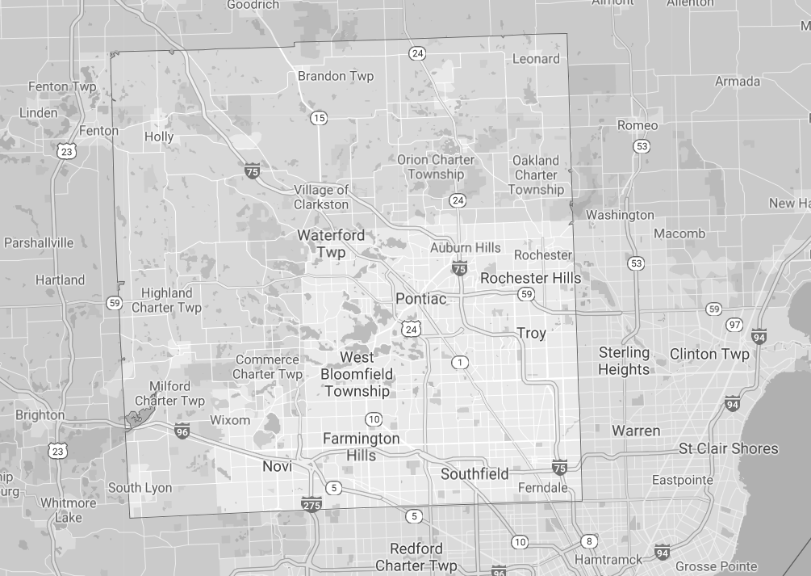

Insights: Good Infrastructure with 3 Interstates
75
75
96
75
275
Source: Map – Google Maps, August 22nd, 2021.

Slide 11
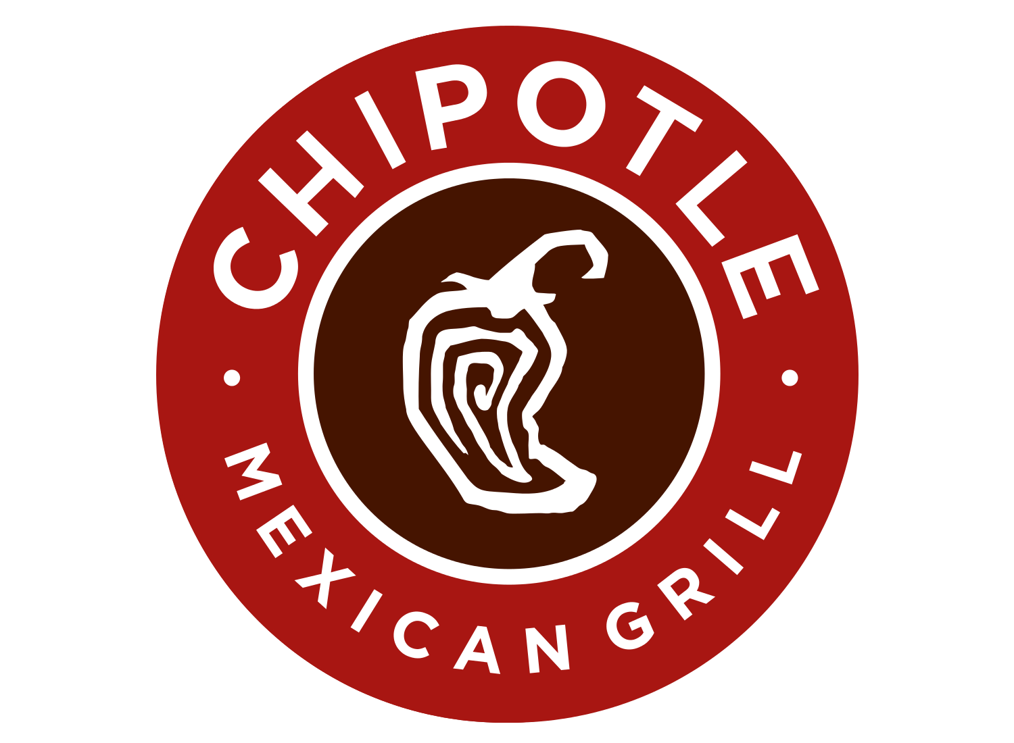


Insights: Peer Competitors
Source: Yelp.com, August 22nd, 2021.

Slide 12
Why not Bergen County?
 | Total Population 2020¹ | Total Population 2025² | Young Population 2025² | Income 100k+ Growth 2025² | Infrastructure
Oakland County, MI | 1,257,982 | 1,273,946 | 31.5% | +8% | 3 Interstates
Bergen County, NJ | 941,439 | 960,829 | 30.3% | +6.3% | 3 Interstates
¹ Estimated for 2020 | ² Projected by 2025
Source: Complete Demographic Summary Report by Gale Business DemographicsNow, Aug. 16th, 2021
Notes:
DARKER PINK OF LOGO:
hexcode #AA3660
RGB (170, 54, 96)
CMYK (14, 27, 14, 89)
LIGHTER PINK OF LOGO:
hexcode #DE5498
RGB (222, 84, 152)
CMYK (8, 75, 4, 0)
GREEN (not required to use because it's not part of their logo):
hexcode #C1C139
RGB (193-193-57)
CMYK (196, 6, 93, 8)

Slide 13
Recommended Next Steps
Select Oakland County and monitor Bergen County
Focus on Novi City
Initiate real-estate research
Adjust Marketing Campaigns
Notes:
DARKER PINK OF LOGO:
hexcode #AA3660
RGB (170, 54, 96)
CMYK (14, 27, 14, 89)
LIGHTER PINK OF LOGO:
hexcode #DE5498
RGB (222, 84, 152)
CMYK (8, 75, 4, 0)
GREEN (not required to use because it's not part of their logo):
hexcode #C1C139
RGB (193-193-57)
CMYK (196, 6, 93, 8)

